Slide 1
FOOD DELIVERO
Abdul Bari 19K-0264
Ariba 19K-0252

Slide 2
Introduction:
This project will facilitate people by delivering them food in the shortest possible time, and a variety of restaurants, online.
It will also ensure to deliver the order in the shortest time to the maximum locations.
Three user ends in total
Admin:
Profit from restaurants
Account to login
Authority to kick out any restaurant which has a rating lower and equals to 2
Check ratings
Restaurant:
Separate accounts for each restaurants
To add, update, delete the products of respective restaurants

Slide 3
Continued…
Customer:
Different location for the delivery purpose
Different food variety
Category (pizza, burger, dessert, continental )
3 to 4 Restaurants of each category
Create an account to log in into the application
Rating of each restaurant after having the order
Notifications/reminders after the order is placed
Calculate bill after the order
Vouchers would be offered occasionally

Slide 4
HEADER FILES USED:
#include<iostream>
#include<fstream>
#include<cstring>
#include<conio.h>
#include<windows.h>

Slide 5
FEATURES UNDER FOOD DELIVERO’ ADMIN

Slide 6
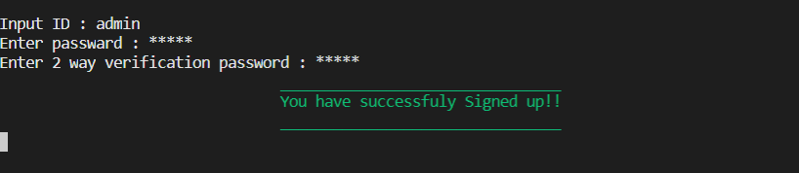
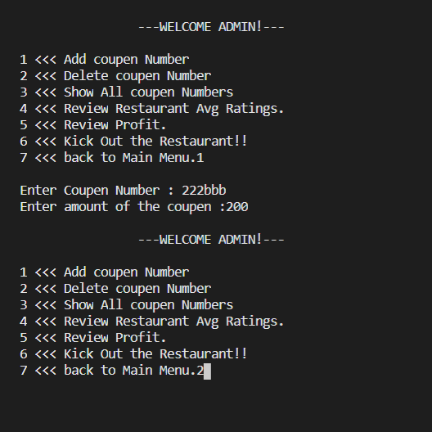

Slide 7
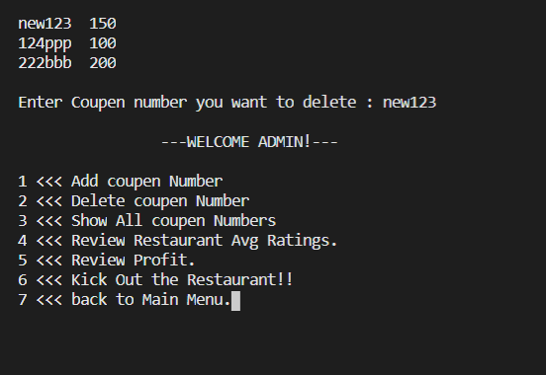
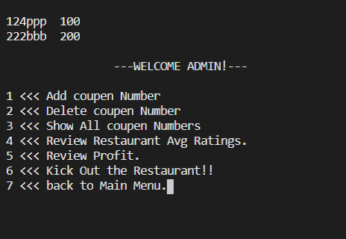

Slide 8
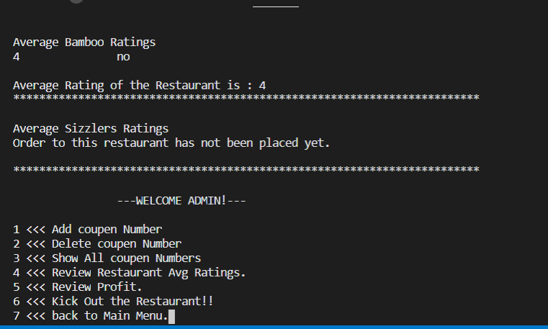
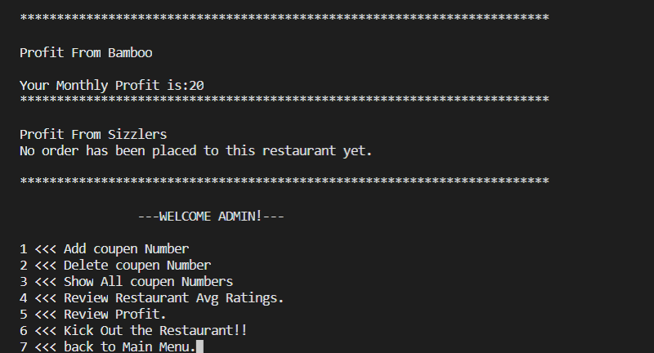

Slide 9
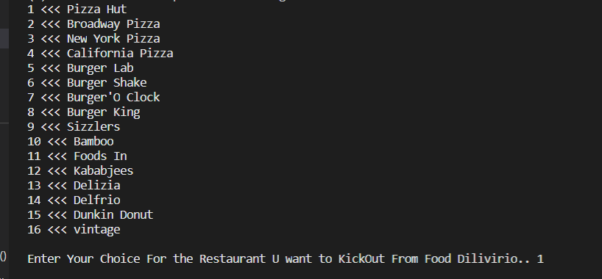

Slide 10
FEATURES UNDER RESTAURANT

Slide 11
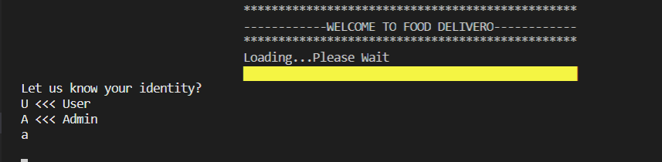
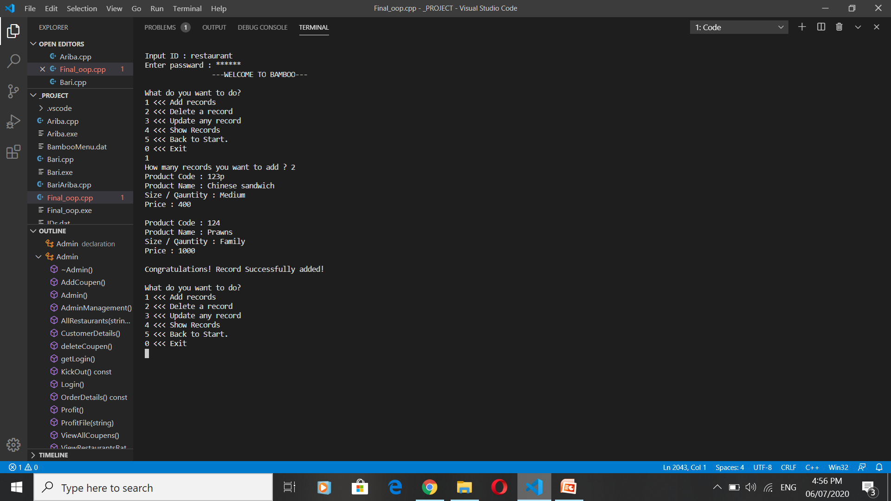

Slide 12
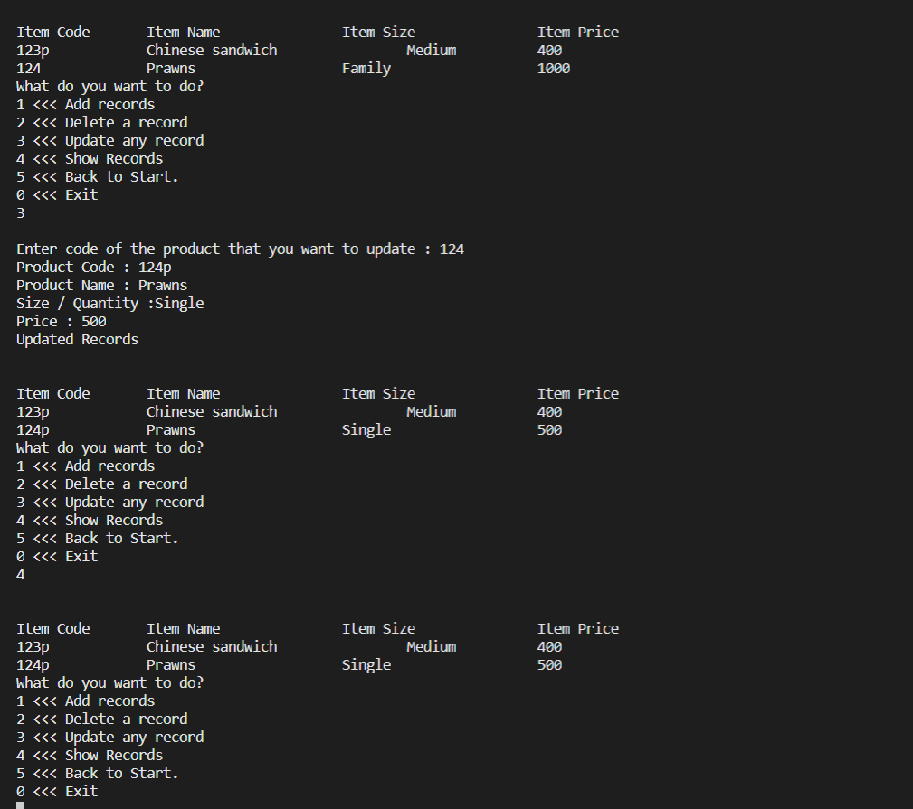

Slide 13
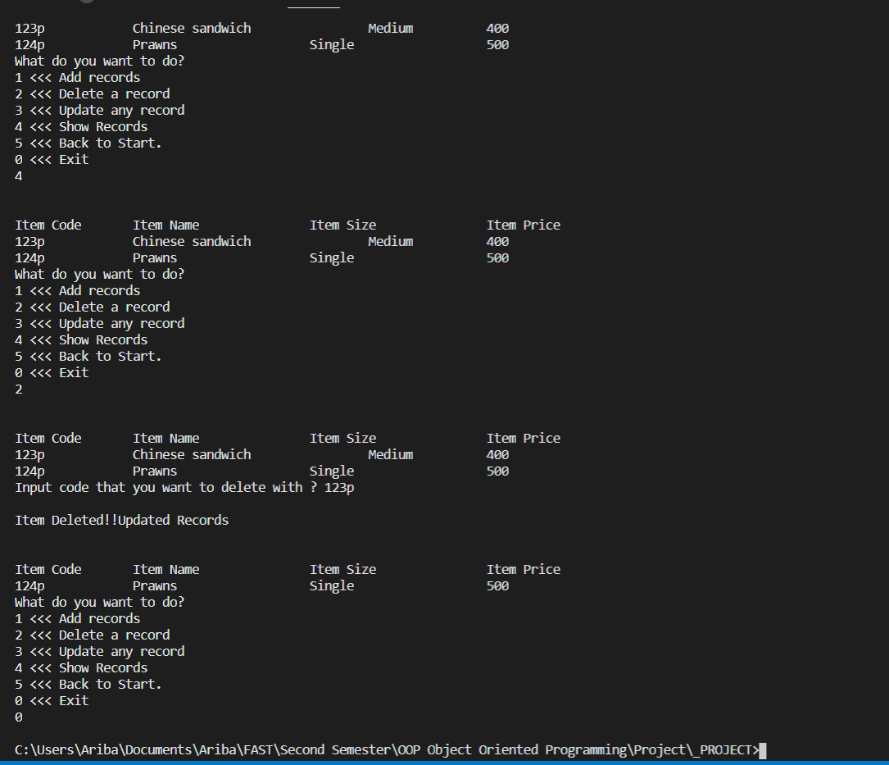

Slide 14
FEATURES UNDER FOOD DELIVERO CUSTOMER

Slide 15
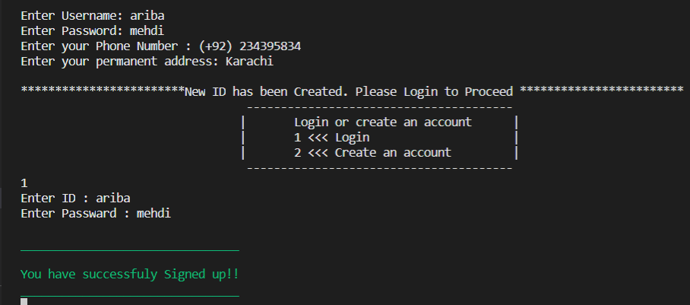
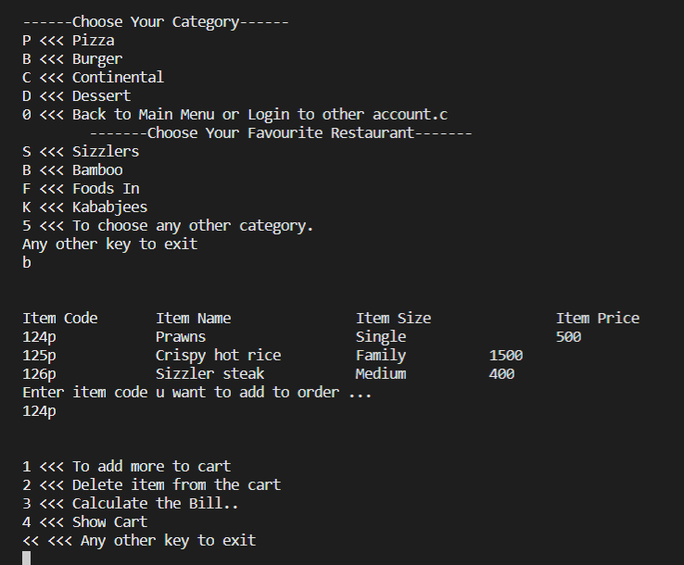

Slide 16
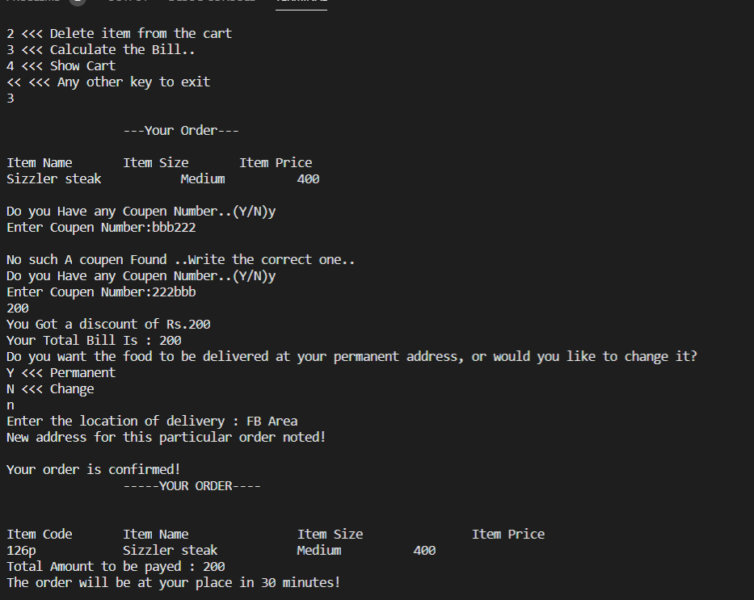

Slide 17
